Slide 1
Shell Design
ME 313: Mechanical Design
Week 5

Slide 2
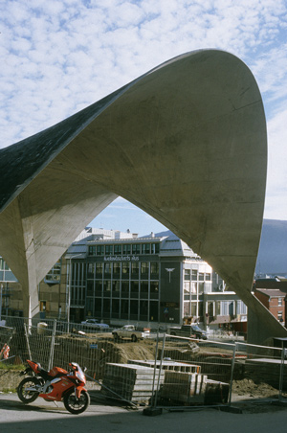
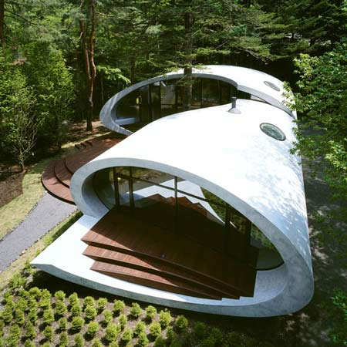
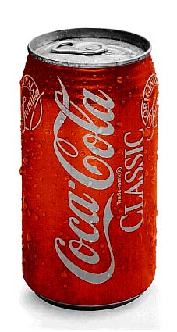
Shell Structures
Curved thin component
Thickness must be much smaller than radius of curvature
Used in roofs, walls, containers, …

Slide 3
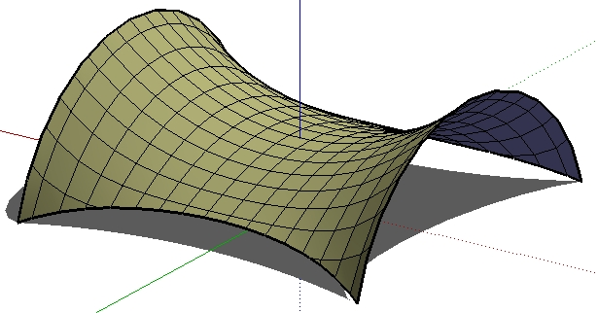

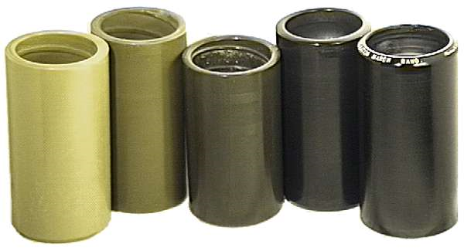
Shell Curvature
Defined by Gaussian curvature
K > 0
K = 0
K < 0

Slide 4
Governing Equation
Force per length depends on the radius of curvature
This is called membrane equation

Slide 5
Applications of Shell Equation
Spherical pressure vessels
Cylindrical pressure vessels

Slide 6
Example: Dented Coke Can

